Slide 1

Data mining –Sentiment Analysis
Tami Farber & Trang Do
Spring 2022
DSC 411: Data Mining

Slide 2
Research Area
Sentiment analysis...
...used to analyze the text-based output of domains like:
Social media
Online reviews
Research papers and other e-Text
Goals
Identify trends
Gather public-opinion
Expose misinformation

Slide 3
Research questions
Which type of machine learning model is best suited for the task?
Is there an ML model that can reliably match the human rating system?
Can we create an ML model that will provide insight into the reviews that might have influenced the human rating system?

Slide 4
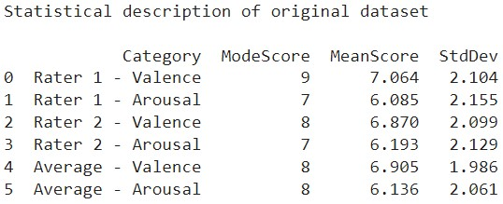
About the dataset
Collected from Yelp! reviews from the Chicago area
Rated for valence and arousal by professional raters (humans)
Made up of 2000 instances with 9 features

Slide 5
Data mining techniques - Data Preprocessing
Step 1: Transform 1-9 ranking scale into five possible categories
negative [1-2]
somewhat negative [3-4]
neutral [5]
somewhat positive [6-7]
positive [8-9]

Slide 6
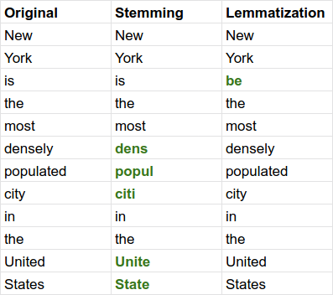
DATA MINING TECHNIQUES - Data Preprocessing
Step 2: Clean the reviews
Adjust misspelled words
Ex: gooddddd -> good
Remove urls, stop words, punctuation
Lemmatize text

Slide 7
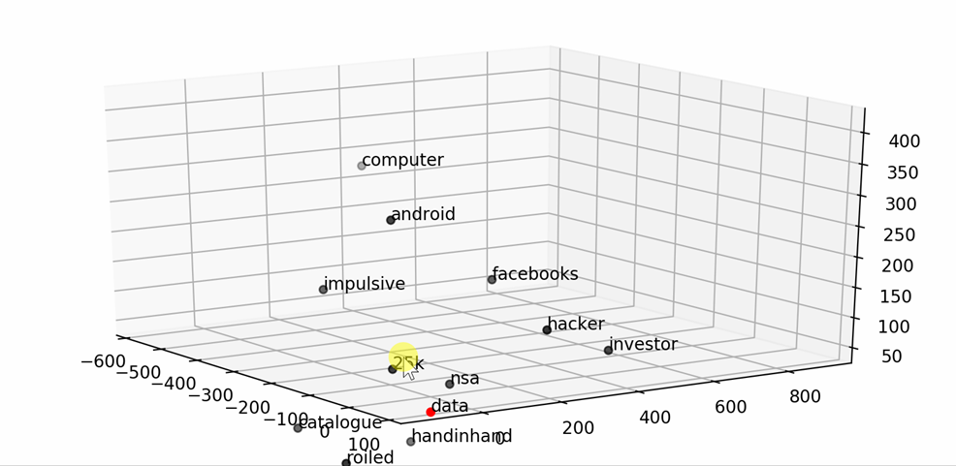
Data mining techniques - Data Preprocessing
Step 3: Transform reviews with TF-IDF Vectorizer
Transform the cleaned text to vectors that can be used to analyze the text
Transform data for models requiring boolean values (0 and 1)

Slide 8
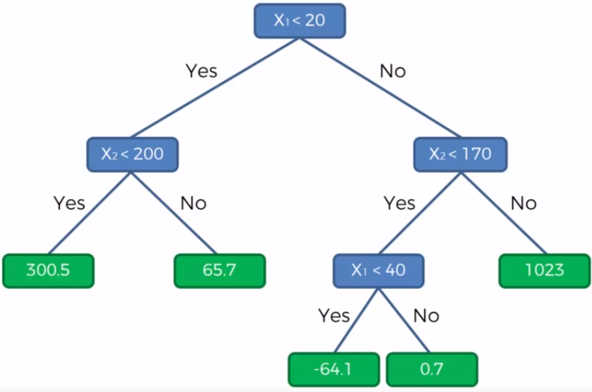
Data mining techniques - Basic Classifications
1. Decision Tree
Supervised learning technique
Similar to a flowchart with tree structures of all the possible solutions to a decision, based on conditions
Decides whether an instance satisfies a condition or not, continuing passing it to next condition until it reaches a decision

Slide 9
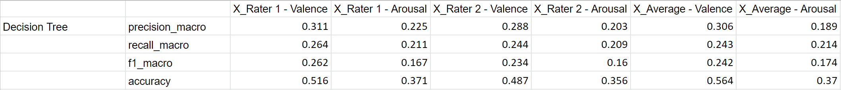
Data mining techniques - Basic Classifications
1. Decision Tree – Model Validation
Took ~600 seconds

Slide 10
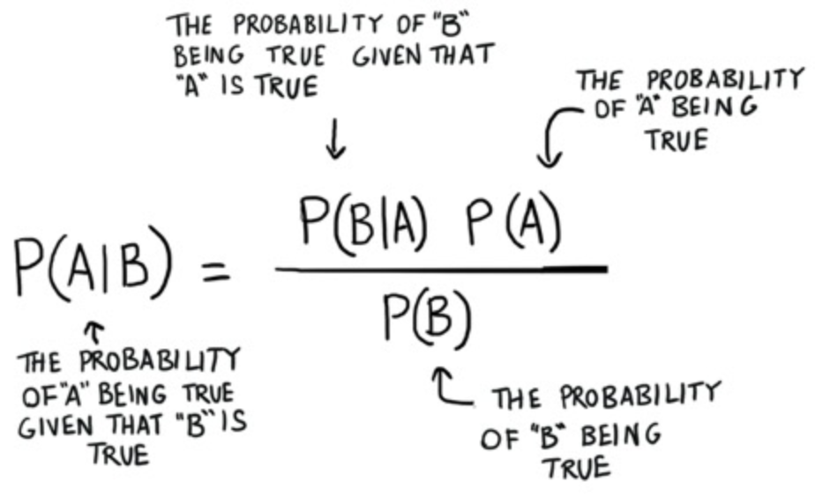
DATA MINING TECHNIQUES - Basic Classifications
2. Multinomial Naïve Bayes
One type of Naive Bayes Classification - a classification technique based on probability calculations of an event given a condition
Considers term frequency
=> Commonly used for text mining

Slide 11
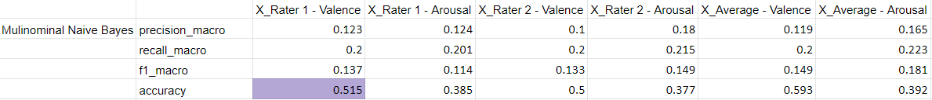
DATA MINING TECHNIQUES - Basic Classifications
2. Multinomial Naïve Bayes – Model Validation
Took ~52 seconds

Slide 12
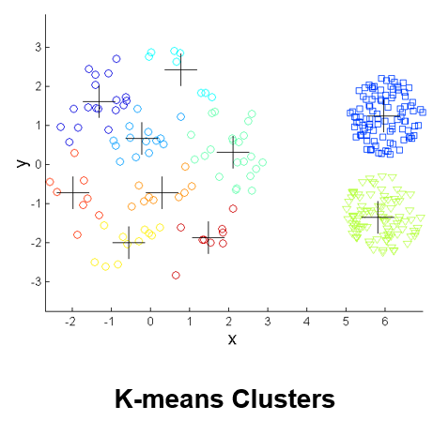
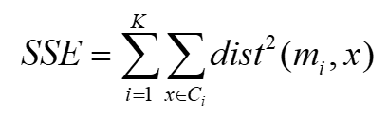
DATA MINING TECHNIQUES - Basic classifications
3. K-means Clustering
Unsupervised learning model
Requires normalized or vectorized data
Generates k clusters of each data point around a centroid
Uses distance measures to create optimal clusters
SSE: sum of least squares
Cluster labels can be compared to known target labels to test model predictions

Slide 13
Data mining techniques - Basic Classifications
3. K-means Clustering – Model Validation
Model was built with 5 clusters to approximate the number of class labels
Labels were encoded to match format of cluster labels
Single cluster data point is the normalized collection of words in a single review
With 10-Fold cross-validation, takes ~ 1 hour to complete
Notes:
For our purposes, the data points in each cluster represent all of the words in one review, based on a measure of the frequency of the words in the collection of reviews. After the data was modeled, the transformed target labels were passed to the validation metrics. Each of the six target attributes were matched to the assigned clusters to measure the models’ ability to predict. We used 10-old cross-validation and requested metrics of completeness, performance better than random, and the harmonic mean between homogeneity of the data and completeness.

Slide 14
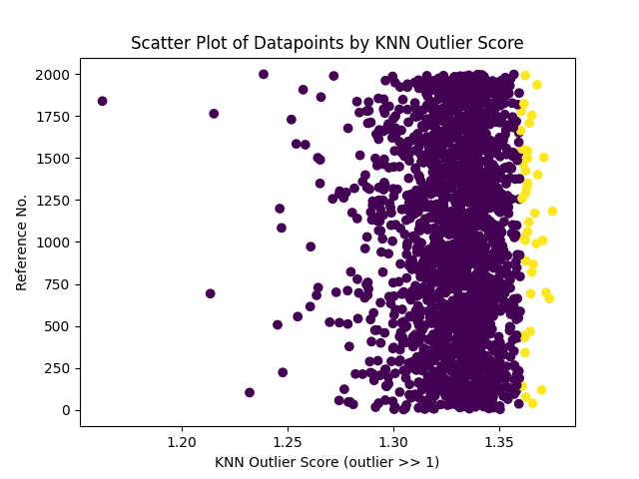
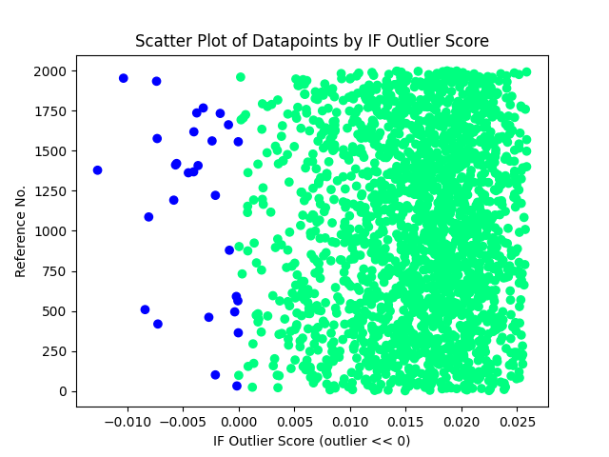
DATA MINING TECHNIQUES - Anomaly detection
An anomaly is data that stands out from the rest
In sentiment analysis and text mining, anomalies can add insight or complicate our model.
Error
Insignificant noise
Unexpected truth

Slide 15
DATA MINING TECHNIQUES - Anomaly detection
1. Isolation Forest
Starts with a single tree...
Random data point is assigned to the root node
Random partitions are chosen
Decisions branch until a termination node is reached
The roots with the shortest paths are scored and labeled anomalous
Labels: outlier/anomaly = –1 inlier = 1
Scores are values between -1 and 1, the closer to –1 a score, the more anomalous

Slide 16
DATA MINING TECHNIQUES - Anomaly detection
1. Isolation Forest - Partial Result
Modeled on our dataset, Isolation Forest identified 29 anomalies.
It seemed to isolate the lengthier reviews [1,322 words to 4,988 words]:
"Growing up on 10th Street in Park Slope, Brooklyn we had several outstanding Pizzeria's to choose from. So when taking my daughter and her fiance on a pizza quest I naturally had to stop in my old neighborhood and sample a slice from Anellio's, which wasn't there anymore. Instead Peppino's Brick Oven Pizzeria now occupies the location. I quickly looked up the comments on Yelp and saw that it was rated very high. Inside did not resemble anything from the old business. It does not resemble the familiar take style counter near the entrance, but rather a sit down set up. The Brick oven is now in the back in plane sight. We were greeted by a hostess and opted to take the Pizza to go. We ordered the Margarita with Meatballs. We sat at a table while we waited the the young girl brought us to go cups of water. Very nice touch. Within a few minutes our Pizza was ready. Brick ovens do cook very quickly. The Pizza looked and tasted fantastic. Sauce was sweet and fresh, the Mozzarella was fresh not the commercial shredded type, the meatballs were sliced homemade. The crust was thin, but not too thin. Not burned as most brick oven pizza can be. Texture of the crust was light, not chewy, with just the right amount of pull as you bite. Overall and excellent PIE. Good Service. My neighborhood still Rocks Great Pizza! "

Slide 17
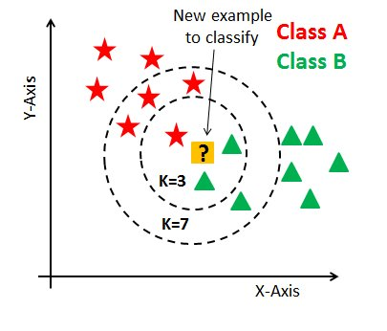
Data mining techniques - Anomaly Detection
2. K-nearest Neighbors (KNN)
The unlabeled data point is likely to have the label of the major class of its k nearest neighbors
The outlier score of an object is the distance to its k nearest neighbors
=> The higher the outlier score, the more likely a data record is an outlier

Slide 18
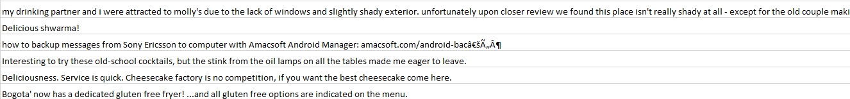
Data mining techniques - Anomaly Detection
2. K-nearest Neighbors (KNN) - Partial Result
KNN model chose reviews with most unique words like “confetti”, “bon endroit”, “schwarma”, and “Bourdain”

Slide 19
Data mining techniques - Advanced Classifications
1. Bernoulli Naïve Bayes
Another type of Naive Bayes Classification - a classification technique based on probability calculations of an event given a condition
Only considers presence of a word
Also used in text mining

Slide 20
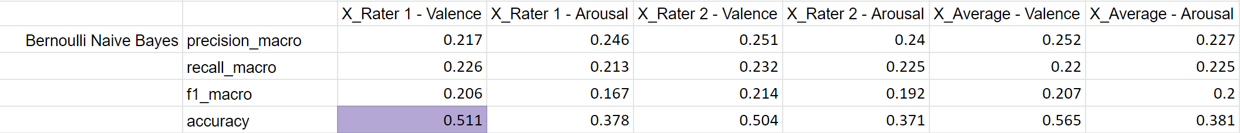
Data mining techniques - Advanced Classifications
1. Bernoulli Naïve Bayes – Model Validation
Took ~62 seconds

Slide 21
Data mining techniques - Advanced Classifications
2. Rules-based Classification
Classifies records by using a collection of “if...then...” rules
IF clause – antecedent & THEN clause – consequent
We used an indirect method to generate rules
Extract rules from Decision Tree
Only considers presence of words, not frequency

Slide 22
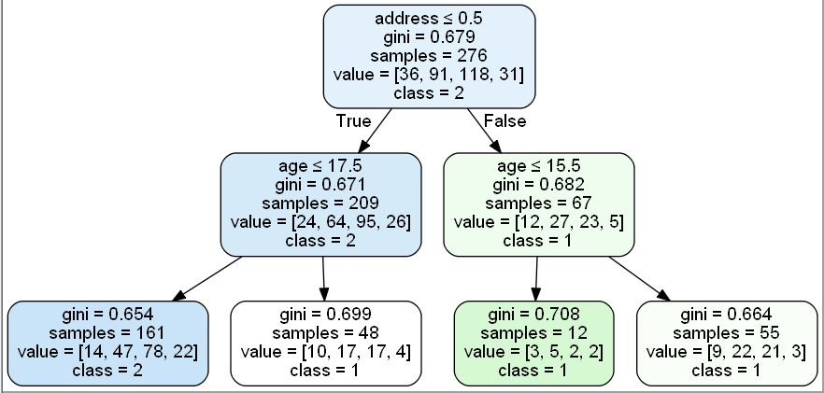
Data mining techniques - Advanced Classifications
2. Rules-based Classification
Traverse decision tree
Nodes store threshold/condition, class label and count of each label in that decision path
=> Allows us to calculate accuracy and coverage
For our dataset
Node threshold is 0.5
If a word in antecedent is >= 0.5, the word is present in a sentence
If a word is <0.5, the word is not present in a sentence

Slide 23
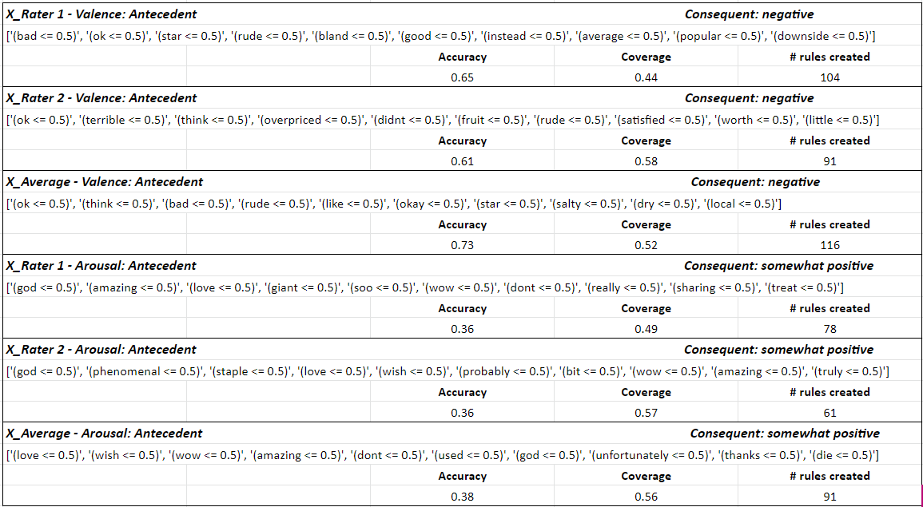
Data mining techniques - Advanced Classifications
2. Rules-based Classification – Top rule for each target

Slide 24
Data mining techniques - Advanced Classifications
2. Rules-based Classification – Top rule for each target

Slide 25
Data mining techniques - Advanced Classifications
3. Artificial Neural Networks (ANN)
Train models using layers of nodes with "neurons"
Iterative tuning process
Creates unseen internal rules
Takes normalized, vectorized, and encoded data

Slide 26
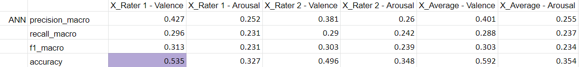
Data mining techniques - Advanced Classifications
3. Artificial Neural Networks (ANN) – Model Validation
MLP Classifier Model was built with 3 layers - input, hidden, output
Used "relu" activation function
The hidden layer trained on 50 neurons
Labels were encoded to match format of cluster labels
With 5-Fold cross-validation, takes ~ 2+ hours to complete
Notes:
‘relu’, the rectified linear unit function, returns f(x) = max(0, x)

Slide 27
Result
Which type of machine learning model is best suited for the task?
Multinomial Naïve Bayes: accuracy better on average , favors valence rating
All valence models had accuracy score of 50% or better
Bernoulli Naïve Bayes: average accuracy of 45%
All valence models had accuracy score of 50% or better
Artificial Neural Network (MLP Classifier): average accuracy of 44%
Similar success with valence over arousal
Computationally expensive, evident in runtimes

Slide 28
Result
Is there an ML model that can reliably match the human rating system?
None of the models perform well when learning the arousal sentiment
Best arousal prediction was Multinomial Naïve Bayes at 39.1%
Precision, recall, and F1 scores are all low
Human language is complex, varied, and full of slang

Slide 29
Result
Can we create an ML model that will provide insight into the reviews that might have influenced the human rating system?
Rule-based organized frequent itemsets of words in logical and easy to follow manner
Rules show a trend toward contextual matching of sentiment
Relevance and relationship between words is easy to spot
Not computationally expensive to create rules

Slide 30
summary
We preprocess data by removing unnecessary words and characters, lemmatizing text, transform word to vectors
We perform different Classification techniques to predict class labels of our 6 target attributes
We found that Multinomial Naïve Bayes was most suitable for our dataset
None of the techniques we implemented can reliably match the human rating system
Rule-based organized the frequent itemsets of words that can provide insights into the reviews
We also perform anomaly detection to detect text anomalous to the dataset
We learn to utilize documentation to implement different models
We learn to preprocess and analyze textual data with different models

Slide 31
References
Stemming vs Lemmatization | Baeldung on Computer Science
python - Traversal of sklearn decision tree - Stack Overflow
Text Classification with NLP: Tf-Idf vs Word2Vec vs BERT | by Mauro Di Pietro | Towards Data Science
Como funciona o algoritmo KNN » Computer Science Master
Machine Learning Series Day 3 (Naive Bayes) | by Alex Guanga | Becoming Human: Artificial Intelligence Magazine
Decision Tree Regression in 6 Steps with Python | by Samet Girgin | PursuitData | Medium
K-means images: Introduction to Data Mining 2nd Edition, Cluster Analysis: Basic Concepts and Algorithms

